Slide 1
Introduction to Customs Control of Chemical Shipments
Notes:
Key Points:
We begin with an introduction to strategic chemicals

Slide 2
Range of chemicals of interest to Customs
Narcotics and their precursors
Explosives and their precursors
Propellants and their constituent chemicals
Miscellaneous chemicals used in producing WMD
Chemical weapons (CW) agents and their precursors
CWC focuses on “Scheduled chemicals”
Precursors are chemical ingredients from which other chemicals are produced, or “synthesized”
Notes:
Key Points:
The most obvious types of strategic chemicals are those related to chemical weapons: CW agents themselves and the chemicals used to make them (precursors)
However, there are many other types of strategic chemicals with different concerns
Explosives and their precursors
Propellants for missiles and their constituent chemicals
Other chemicals used in producing WMD, such as particular chemicals used in the nuclear fuel cycle
In all cases, precursors – chemical ingredients used to make or “synthesize” other chemicals – or other component chemicals are important strategic chemicals and should not be easily dismissed.
Background Info:
Customs Officers are probably familiar with the term “precursor” defined in the text box due to work in disrupting illicit trafficking in drug (narcotics) precursors.

Slide 3
Identifying Shipments of Chemicals
To control transfers and collect data, Customs needs to identify shipments of chemicals
Customs Officers do not need chemical expertise to take positive steps toward identifying chemicals
Documentation, labels, and markings can provide valuable information while reducing contact with hazardous chemicals
Coupled with technical reachback – and possibly sampling and analysis – this information can aid in the identification of chemicals
Notes:
Key Points:
It is possible for Customs Officers to help in the identification of strategic chemicals without significant chemistry knowledge
The key knowledge is not chemistry – it is the type of information that can be gleaned from chemical packaging, labeling, and documentation that can aid identification.
Consulting labels and documentation has the added benefit of minimizing exposure to what are often very hazardous materials.
Understanding what type of information in a chemical shipment is informative and reliable can help in gathering data for technical reachback specialists, who in turn can help identify the chemical and determine if it is strategic.
Background Info:

Slide 4
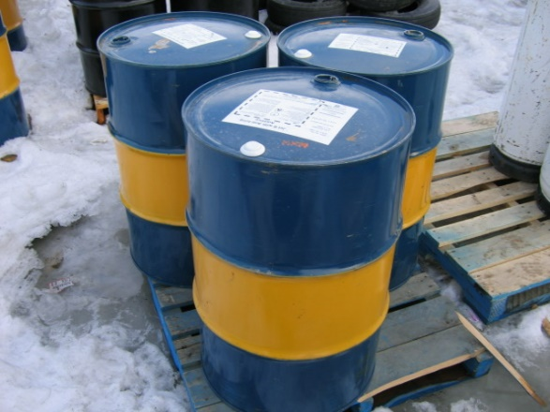
Strategies for Identifying Chemicals
Identify by physical appearance
Mainly colorless or yellow liquids or white powders, just like normal chemicals = not reliable
Identify by declarations, labels, and documents
Declarations, labels, markings, and certain documents can contain identifying information = useful, if correct
Identify by chemical analysis
More definitive, but requires proper sampling and analysis = time, money, equipment, and expertise
?
Front-line officers focus on using declarations, documents, labels, and markings for chemical identification
Notes:
Key Points:
Stepping back, we can envision three main strategies for identifying a chemical substance:
First, we might look at the appearance of the chemical substance itself – however, this is doomed to failure because so many chemicals look the same
In addition, this risks exposure to hazards
Chemical appearance might allow you to identify a misdeclaration if – for example – the substance is a solid and the declared material is a liquid, but it will still not help with positive identification
Second, we could look at the packaging and documentation for the shipment
The type of packaging won’t be illustrative, but if the labels and documentation are complete and truthful they can tell you a lot about what the chemical is
Finally, the chemical could be sampled and sent for analysis to a Customs Laboratory (or analyzed in the field if the appropriate equipment is available)
If sampling is representative and the analysis accurate, this can definitively identify the chemical. However, it is time consuming and costly, and it requires appropriate equipment and expertise
For these reasons, our focus will be on using data from labels, marking, and documentation to assist chemical identification.
Background Info:
The issues of sampling and analysis will be covered later in the module as part of a discussion on the role of Customs Laboratories in chemical identification.

Slide 5
Summary
Chemicals often difficult for customs to identify
Many different forms of packaging
Many different trade and common names for the same chemical
Sampling and analysis too costly to use routinely
Safety issues
Declarations, documents, labels, and markings provided with the chemical have a number of useful chemical identifiers that customs can use to check the identity of chemicals
We will consider the use of these identifiers in detail in subsequent presentations

